Slide 1
Introduction to ReactJS, MongoDB

Slide 2
ReactJS setup
Follow instructions for local installation at:
https://reactjs.org/tutorial/tutorial.html
Create React App locally:
npm install -g create-react-app
npx create-react-app
Follow instructions for creating a TicTacToe game frame
Taken from: https://reactjs.org/tutorial/tutorial.html

Slide 3
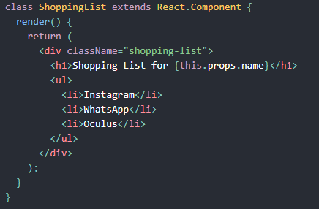
What is React?
React is a declarative, efficient, and flexible JavaScript library for building user interfaces.
It lets you compose complex UIs from small and isolated pieces of code called “components”.

Slide 4
React Component Class
Component tell React what we want to see on the screen
A component takes in parameters called props
Render method returns a description of what you want to see on the screen
Render returns a React element that describes what to render
React developers use JSX for writing structures to be rendered
JSX is an XML/HTML-like syntax that allows us to put HTML into JavaScript
React components can be composed and rendered as required
Each React component is encapsulated and can operate independently
This allows building complex UI4s from simple components

Slide 5
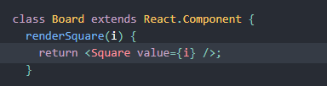
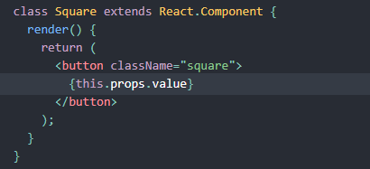
Passing Data Through Props
Change the renderSquare method to pass a prop called value to the Square:
Change Square’s render method to show the square value:

Slide 6
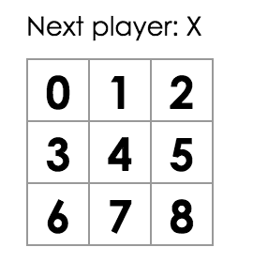
Result of passing a prop
Refresh the browser to see the number in each square
We passed a prop from a parent Board component to a Child square component
Information flows in React apps by passing props from parents to children

Slide 7
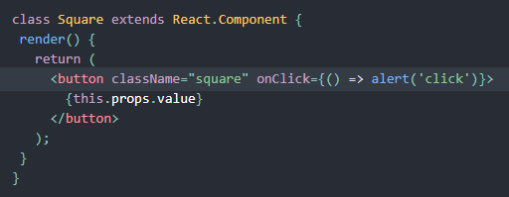
Making an interactive Component
Getting an alert
Note the use of arrow function

Slide 8
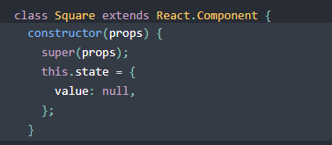
Using state to remember actions
State of a component is to be initialized in a constructor of a component
State should be considered as private to a React component
Add a constructor to the Square class to initialize state
Following JavaScript guidelines, all React component classes with a constructor should have a super(props) call

Slide 9
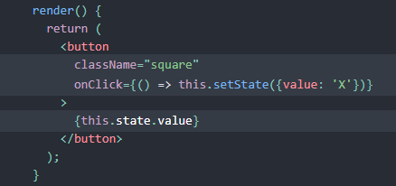
Changing the states
Use this.setState from an onClickhandler in the render method for changing state of a square
Calling a setState in a component will automatically update the child components inside it

Slide 10
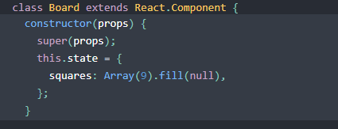
Lifting State Up
To determine winner, the value of each of the 9 squares need to be in one location
Best approach is to store game’s state in the parent Board component
Board tells each square what to display by passing a prop
Ass a constructor to Board and set initial values with 9 nulls

Slide 11
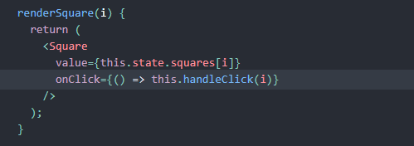
Passing States down to the Squares
Modify renderSquare method to read value from the board’s state
Pass down a function which will get called when a Square is clicked

Slide 12
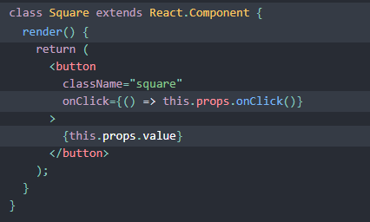
Modify Square Class
Board class passes down two props to Square: value and onClick
Square doesn’t need to keep track of state now, so we can delete square state
Also, delete square constructor and change render to the following:

Slide 13
What will happen when a Square is clicked?

Slide 14
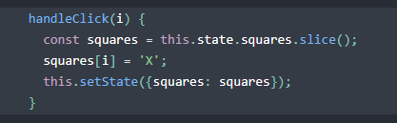
What will happen when a Square is clicked?
We have not defined the handleClick() method yet, so our code crashes
Add handleClick to the Board class
The Square component receive values from Board component
Square components are now controlled components

Slide 15
Mutability vs. Immutability
We used the .slice() operator to create a copy of the squares array instead of modifying the existing array
Mutation refers to changing data directly, other approach is replacing the data with a new copy
Immutability allows us to implement ‘time travel’ – useful for undo and redo operations
Detecting changes in the immutable objects is easier

Slide 16
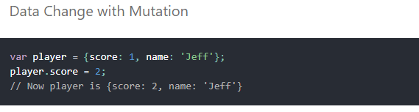
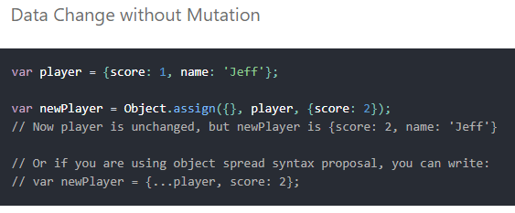
Mutability vs. Immutability

Slide 17
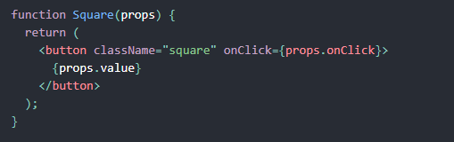
Function Components
React classes which contain only render method and don’t have own state could be converted to function components
Function takes props as input and returns what should be rendered
Replace the Square class with a function

Slide 18
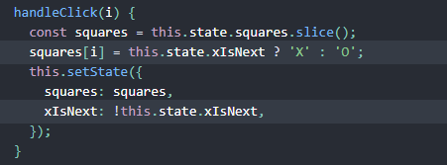
Adding Logic to Take Turns
First move is always X
Add xIsNext: true, to the Board state in it’s constructor
We will flip xIsNext to True or False depending on who is next: X or O
Change handleClick function to change the value of squares and xIsNext depending on the turn
Change status text in Board’s render to display player with next turn
const status = 'Next player: ' + (this.state.xIsNext ? 'X' : 'O’);

Slide 19
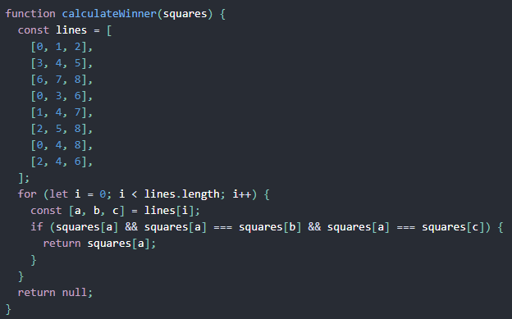
Calculating a Winner – Helper Function

Slide 20
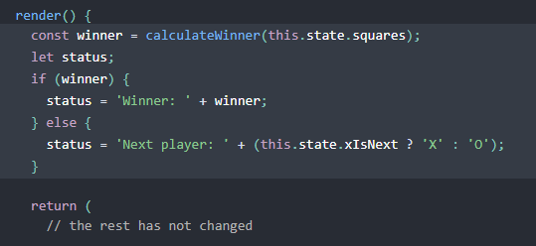
Announcing a Winner
Call calculateWinner(squares) in the Board’s render function
If a player has won, display text such as “Winner: X” or “Winner: O”

Slide 21
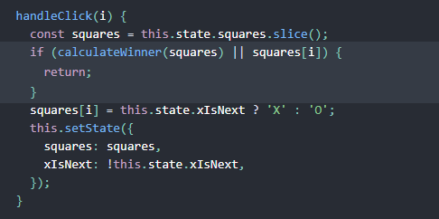
Ignore Clicks if Game is Finished
Change the Board’s handleClick function to return early by ignoring a click if someone has won the game or if a Square is already filled

Slide 22
Adding Time Travel
Homework

Slide 23
Relational vs. Non Relational Databases (RDBMS vs NoSQL)
Relational Databases
Example: Microsoft SQL Server, Oracle DB, DB2
Used in large enterprise scenarios
Non-relational databases
Example: MongoDB, Cassandra
Four categories: Key-value stores, wide-column stores, Document stores and graph stores
Some of these slides taken from: https://www.pass.org/DownloadFile.aspx?File=0141eebe

Slide 24
What is NoSQL?
NoSQL is a class of database management system identified by its non-adherence to the widely used relational database management system (RDBMS) model with its structured query language (SQL).
NOSQL has evolved to mean “Not Only” SQL
NOSQL has become prominent with the advent of web scale data and systems created by Google, Facebook, Amazon, Twitter and others to manage data for which SQL was not the best fit.

Slide 25
Relational Stores
Data Stored in tables
Tables contain some number of columns, each of a type
A schema describes the columns each table can have
Every table’s data is stored in one or more rows
Each row contains a value for every column in that table
Rows aren’t kept in any particular order

Slide 26
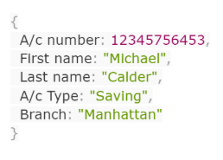
Key-Value Stores
Anything can be stored as a value, as long as each value is associated with a key or a name
Key-value stores offer very high speed via the least complicated data model
The basic data structure is a dictionary or map. You can store a value, such as an integer, string, a JSON structure, or an array, along with a key used to reference that value.

Slide 27
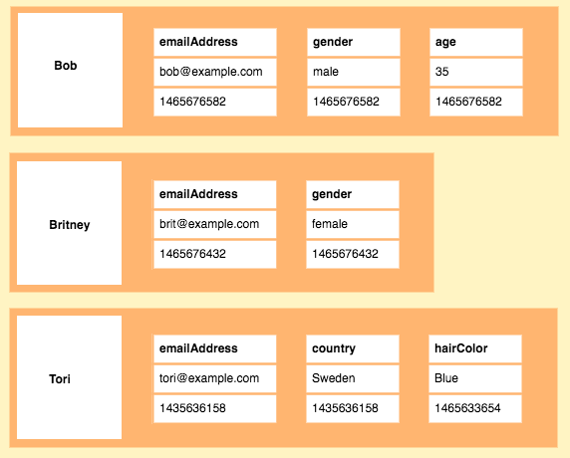
Wide-Column Stores
Also called column stores
Stores data using a column oriented model.
The store contains the column families (like relational tables) which contain rows, which contain columns.
Each column is contained to its row. It doesn’t span all rows like in a relational database. Each column contains a name/value pair, along with a timestamp.

Slide 28
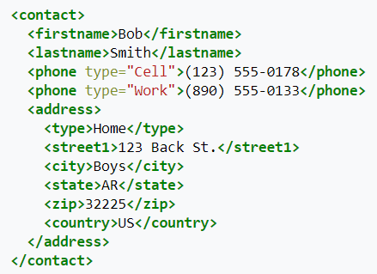
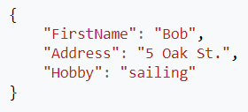
Document Stores
Document stores contain data objects that are inherently hierarchical, tree-like structures (JSON or XML).
Documents in a document store are not required to adhere to a standard schema.

Slide 29
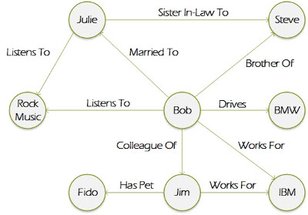
Graph Stores
Uses graphic structures for semantic queries with nodes, edges and properties to represent and store data.
A graph database is essentially a collection of nodes and edges. Each node represents an entity (such as a person or business) and each edge represents a connection or relationship between two nodes.
Graph databases are well-suited for analyzing interconnections.
There has been a lot of interest in using graph databases to mine data from social media.

Slide 30
Use Cases for NoSQL Databases
Key-value stores: [Redis] For cache, queues, fit-in memory, rapidly changing data, store blob data. (Shopping cart, Session Data, Stock Prices). Fastest performance
Wide-column stores: [Cassandra] Real-time querying of random (non-sequential) data, huge number of writes, sensors. (Web analytics, real-time data analytics, time series analytics): Internet scale
Document stores: [MongoDB] Flexible schemas, dynamics queries, defined indexes, good performance on big DB: (Order data, customer data, log data, chat sessions, tweets, ratings, comments). Fastest development
Graph database: [Neo4j] Graph-style data, social network, master data management (fraud detection, graph search, gene sequencing)

Slide 31
RDBMS vs. MongoDB
RDBMS | MongoDB
Database | Database
Table | Collection
Tuple/Row | Document
column | Field
Table Join | Embedded Documents
Primary Key | Primary Key (Default key _id provided by mongodb itself)
SQL query language | Document-based query language
Database Server and Client
Mysqld/Oracle | mongod
mysql/sqlplus | mongo

Slide 32
MongoDB Download and Install
https://www.mongodb.com/download-center/community
Download and install
Create data folder which will be used as default database storage path for MongoDB:
C:\pravinp\SUNYK\Spring2019\Courses\CSE308\project\mongodb\data
Start Mongodb using following command:
"C:\Program Files\MongoDB\Server\4.0\bin\mongod.exe" –dbpath “C:\pravinp\SUNYK\Spring2019\Courses\CSE308\project\mongodb\data”
Taken from https://geekflare.com/getting-started-mongodb/

Slide 33
Creating the First Collection
MongoDB stores the data in the form of JSON documents.
A group of such documentation is collectively known as a collection in MongoDB.
A collection is analogous to a table in a relational database.
A document is analogous to a record in a relational database.
Execute following command from MongoDB home directory to create a database:
C:\Program Files\MongoDB\Server\4.0\bin> mongo tutorial
Create a collection with following command:
> db.createCollection('firstCollection');

Slide 34
Inserting a Document in a Collection
Insertion of the first JSON document into the firstCollection
> db.firstCollection.insertOne({name:'Abhishek',skill:'MongoDB’});
Find above document from the collection
db.firstCollection.find(); //Fetches all available documents
Insert another document in the collection
> db.firstCollection.insertOne({name:'GeekFlare',skill:'Java,MongoDB,NodeJS’});
Try following commands:
db.firstCollection.find();
db.firstCollection.find({name:'Abhishek'}); //using filter
db.firstCollection.find({skill:/.*MongoDB.*/}); //filter using regex
db.firstCollection.find({skill:/.*Java.*/}); //filter using RegEx

Slide 35
Complex Queries in MongoDB
Operators such $or, $and as well as $not could be used for query operations
E.g. get the list of documents where name attribute contains Abhishek or skill contains Java.
db.firstCollection.find({$or: [{name:'Abhishek'},{skill:/.*Java.*/}]});

Slide 36
Complex Queries in MongoDB
Create another collection
db.createCollection('studentmarks’);
Insert a document in studentmarks collection
db.studentmarks.insertMany([{name:'A',marks:20},{name:'B',marks:25},{name:'C',marks:22},{name:'D',marks:30}]);
Use operators such as greater than ($gt), less than ($lt) or not equal to ($ne)
db.studentmarks.find({marks:{$gt:22}});

Slide 37
More operators
Operator | Use | Example
$eq | Check if the value is equal | {marks:{$eq:20}}
$lt | Check if value is less than | {marks: {$lt:20}}
$gte | Check if value is greater than or equal to | {marks:{$gte:22}}
$lte | Check if value is less thank or equal to | {marks:{$lte:22}}
$ne | Check if value is not equal to | {marks:{$ne:22}}
$in | Check if value is equal to either of the values from the array | {marks:{$in:[20,22]}}
$nin | Check if value is not equal to any value from the array | {marks:{$nin:[22,25]}}

Slide 38
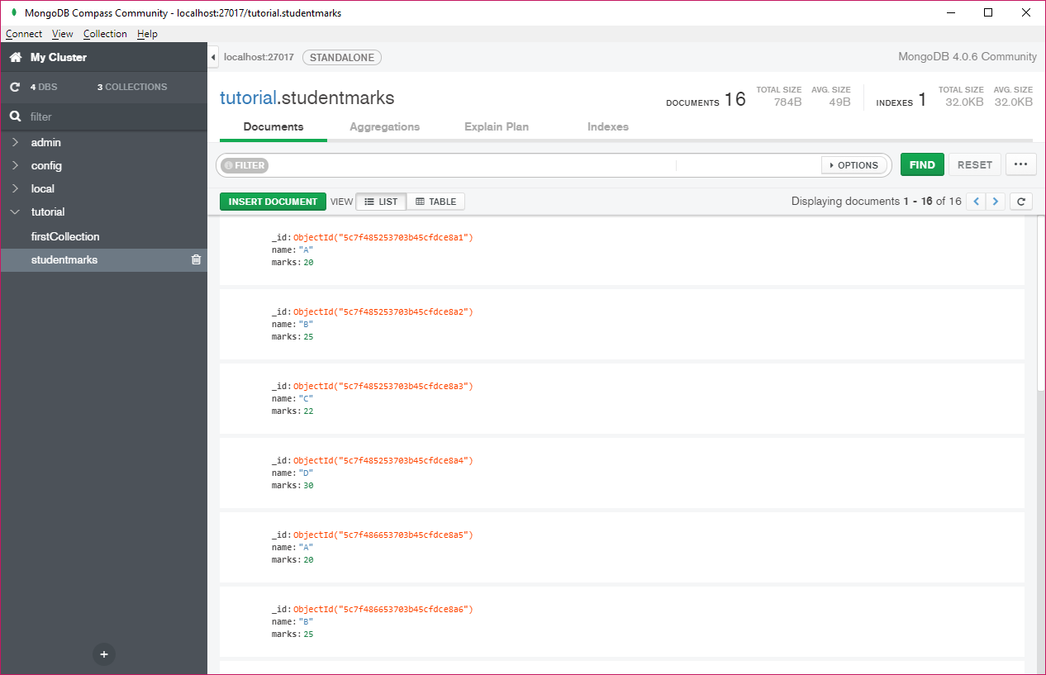
MongoDB Compass GUI

Slide 39
Individual Homework Assignment
A user logins using Facebook
A map pops up showing user's current location
User is able to create/edit/delete a basic contact profile by clicking user account button
React Native location tracking:
https://medium.com/quick-code/react-native-location-tracking-14ab2c9e2db8
Facebook OAuth in React Native
https://alexanderpaterson.com/posts/add-social-authentication-to-a-react-native-application
Building Spring Boot, MongoDB and React.js CRUD Web Application
https://www.djamware.com/post/5ab6397c80aca714d19d5b9c/building-spring-boot-mongodb-and-reactjs-crud-web-application

